Slide 1
Electronic Devices Inventory Management System for Suppliers
Microsoft Data Engineer Track
Mohamed Eldagla, Sat 19 October, 2024

Slide 2
Agenda
Role Played for each member
Project Overview
Goals
Role Played [Mohamed Eldagla]
Other Team Members and their Work

Slide 3
Role Played for each member
Mohamed Eldagla: Context Diagram, Database Design [ERD & Data Dictionary], Database Creation and Implementation.
Yousef Ibrahim: DB Schema & Kivy Application GUI.
Ahmed Abdelnasser & Nermin Ahmed: Python Scripting, Data Ingestion, Data Transformation & Star Schema.
Mahmoud Sayed: ML Model & Power BI Report.
Nermin Ahmed: Star Schema.

Slide 4

Project Overview
The purpose of the Electronic Devices Inventory Management System is to provide a comprehensive and user-friendly solution for efficiently managing the inventory of electronic devices within a retail or distribution environment.
It aims to streamline inventory-related operations, enhance the sales process, improve inventory accuracy, and provide valuable insights for data-driven decision-making.

Slide 5
Goals
Efficient Inventory Management: Ensure real-time tracking and management of electronic device inventory to minimize overstock and stockout situations.

Slide 6
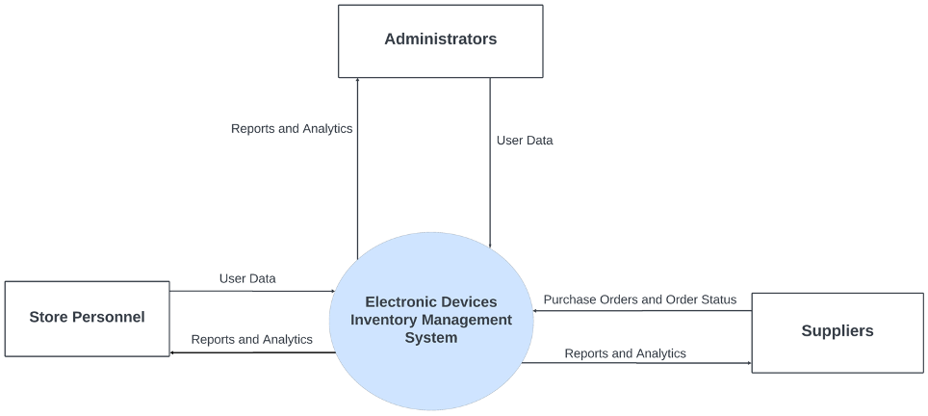
Context Diagram

Slide 7
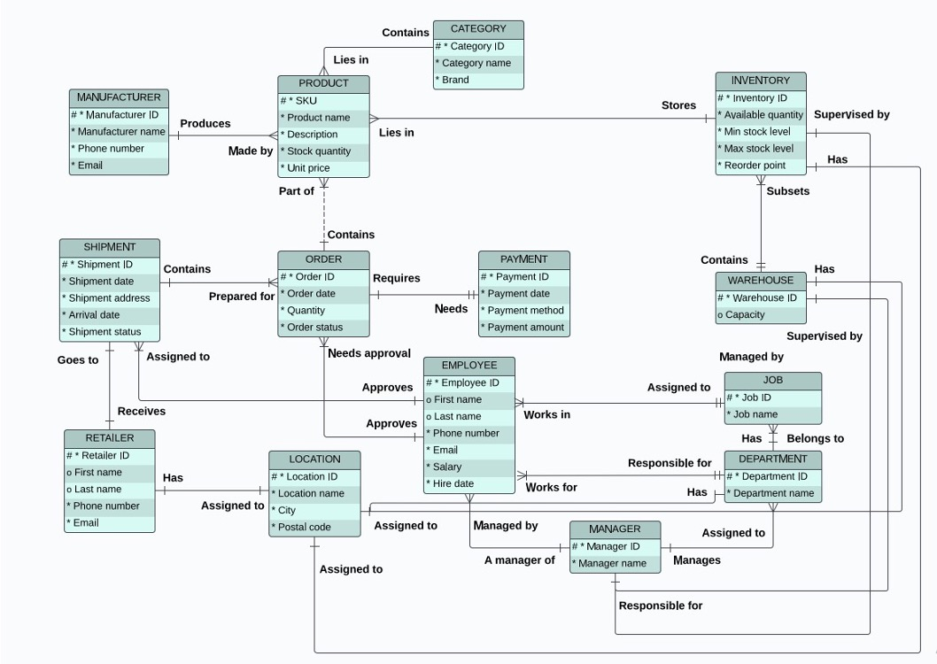
Entity Relationship Diagram

Slide 8
Check Excel for Data Dictionary

Slide 9
Check Queries

